Slide 1

Microservices Cloud Simulator (MCS)
Scalable, ESDL based, energy system simulator (GO-e WP3.3B)

Slide 2
Energy system Microservices Cloud Simulator
A simulation framework to model energy systems described using ESDL
Independent development of calculation services per energy object
Configurable boiler plate project as a starting point
Simulations run on a cloud cluster with scalable calculation services
Created for GO-e WP3.3B
Mark Vrijlandt, Ruduan Plug, Edwin Matthijssen
TUE: Bart van der Holst, Gijs Verhoeven, Koen Kok
TU Delft: Arjen van der Meer

Slide 3
Overview
GO-e WP3.3B Goals
Microservices Cloud Simulator
Develop calculation services
Run a simulation
First simulation results

Slide 4
GO-e WP3.3B goal
“Investigate by means of simulations how effective DSOs can activate flexibility from the built environment using various combinations of flexibility activation mechanisms to prevent congestion in Dutch distributions”
This requires many simulations for large energy systems:
5 (networks per DSO) x 3 (DSOs) x 8 (Archetypical Neighborhoods) = 120 networks
Evaluate different flexibility activation mechanisms
Different scenarios for #flexible assets, weather, electricity prices in various markets
Costly optimizations involved due large number of energy assets

Slide 5
GO-e WP3 IT goals
Use ESDL to describe energy systems
Run simulations on a scalable (cloud) cluster
Independent development of calculation services
TUE focus on implementing calculation logic without worrying about:
Cluster setup and deployment
Communication between the different components
Starting service calculations when needed during the simulation
ESDL parsing
Setup and writing to database and visualizing results
Setup local testing of single calculation services with required infrastructure

Slide 6
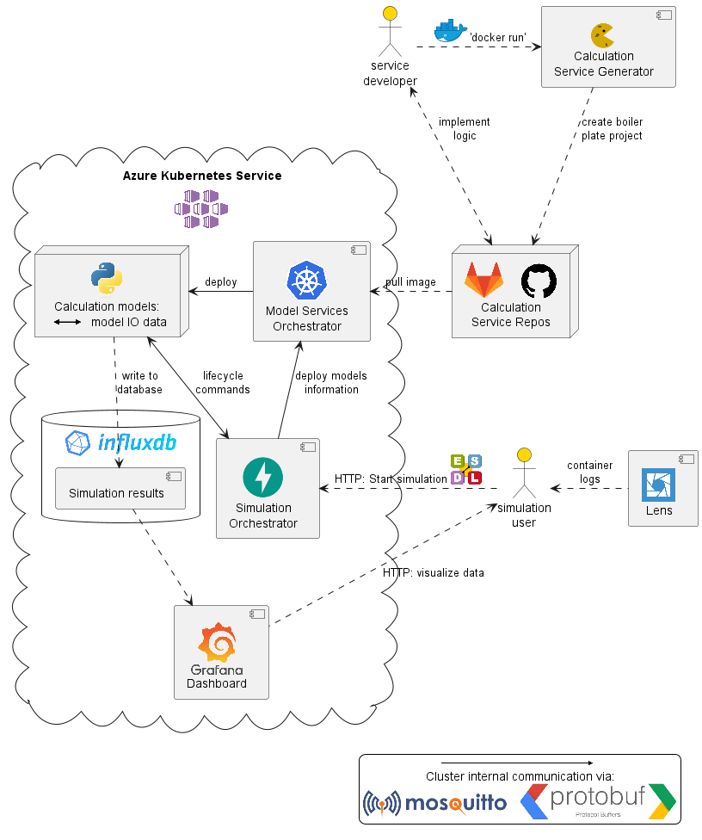
Microserves Cloud Simulator
3
Three main repositories
Simulation Orchestrator Start and manage simulations via a REST API FastAPI
Model Services Orchestrator Deploy and manage calculation service models on Kubernetes Python asyncio-mqtt, kubernetes python client
Calculation Service Generator Create calculation service boiler plate code from a configuration yaml file Cookiecutter, Jijnja2
1. and 2. are deployed on AKS
3. is used via ‘docker run’
2
1

Slide 7
Development of Calculation Services
2
1
Define expected input and output data per calculation
Create boiler plate Python project (‘docker run’) which:
Can be deployed on Kubernetes
Parses ESDL to get attribute values and connected ESDL objects
Contains I/O data classes with protobuf parsing
Sends/receives lifecycle and data MQTT messages
Starts calculations when all expected data has been received and sends output
Writes to InfluxDB
Closes down when simulation is done or terminated
Local testing setup
Implement logic Local testing Push docker image to online repository
3

Slide 8
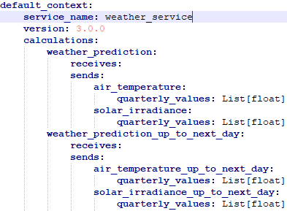
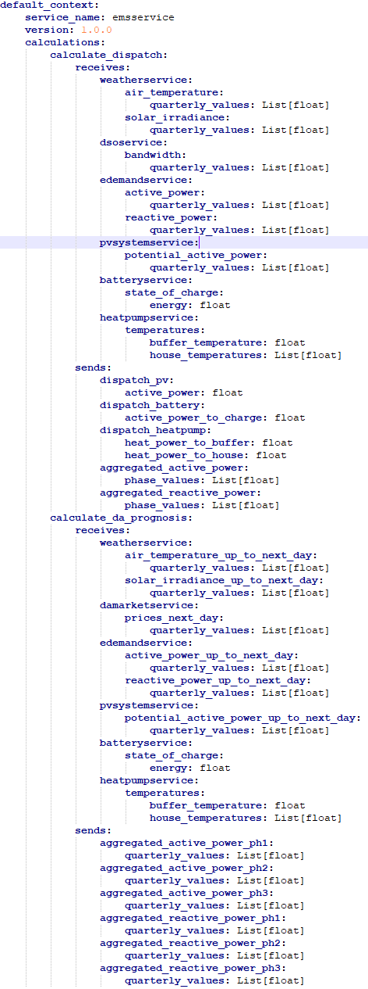
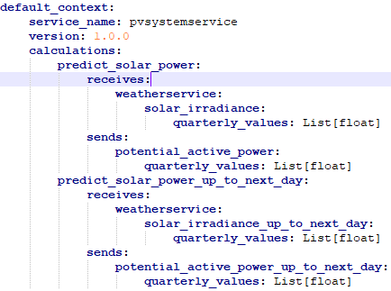
GO-e calculation service configuration

Slide 9
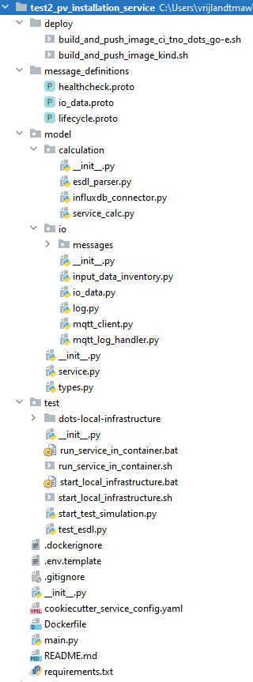
Boiler plate project
Implement logic: ‘model/calculation/service_calc.py’
One function per calculation
Receives and sends ‘model/io/io_data.py’ data objects (as in service configuration)
Local testing
‘test/start_local_infrastructure.sh’: mosquitto, influxdb, Grafana on Docker Desktop
`test/start_test_simulation.py’: mock simulation orchestrator and required input data:
Creates test ESDL file
Waits for ‘ReadyForProcessing’ from calculation service, sends ‘ModelParameters’ containing the ESDL file
Sends ‘NewStep’ messages and required input data
run ‘main.py’ or ‘test/run_service_in_container.sh’: start the service model
Finally ‘deploy/build_and_push_image_ci_tno_dots_go-e.sh’

Slide 10
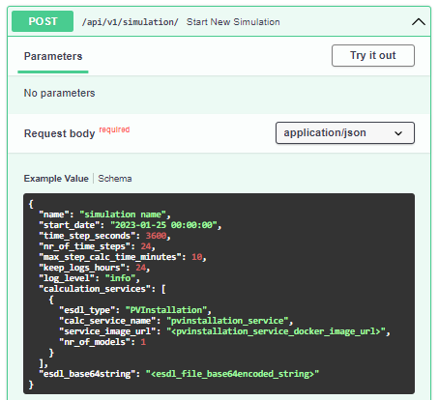
Start Simulation
POST request:

Slide 11
First simulation: POST body
{
"name": "simulation name",
"start_date": "2020-09-06 23:30:00",
"time_step_seconds": 900,
"nr_of_time_steps": 288,
"max_step_calc_time_minutes": 20,
"keep_logs_hours": 1,
"log_level": "info",
"calculation_services": [
{
"esdl_type": "ElectricityDemand",
"calc_service_name": "edemandservice",
"service_image_url": "ci.tno.nl/dots/go-e/edemand_service:12.0.0",
"nr_of_models": 1
},
{
"esdl_type": "EConnection",
"calc_service_name": "emsservice",
"service_image_url": "ci.tno.nl/dots/go-e/ems_service:129.0.0",
"nr_of_models": 10
},
{
"esdl_type": "EnergySystem",
"calc_service_name": "lvnetworkservice",
"service_image_url": "ci.tno.nl/dots/go-e/lv_network_service:4.0.4",
"nr_of_models": 1
},
{
"esdl_type": "Party",
"calc_service_name": "dsoservice",
"service_image_url": "ci.tno.nl/dots/go-e/dsoservice:5.0.0",
"nr_of_models": 1
},
{
"esdl_type": "PVInstallation",
"calc_service_name": "pvsystemservice",
"service_image_url": "ci.tno.nl/dots/go-e/pv-service:2.0.0",
"nr_of_models": 1
},
{
"esdl_type": "Battery",
"calc_service_name": "batteryservice",
"service_image_url": "ci.tno.nl/dots/go-e/battery-service:13.0.0",
"nr_of_models": 1
},
{
"esdl_type": "EnvironmentalProfiles",
"calc_service_name": "weatherservice",
"service_image_url": "ci.tno.nl/dots/go-e/weather_service:5.0.0",
"nr_of_models": 1
},
{
"esdl_type": "EnergyMarket",
"calc_service_name": "damarketservice",
"service_image_url": "ci.tno.nl/dots/go-e/da-market-service:6.0.0",
"nr_of_models": 1
},
{
"esdl_type": "HeatPump",
"calc_service_name": "heatpumpservice",
"service_image_url": "ci.tno.nl/dots/go-e/heatpump-service:14.0.0",
"nr_of_models": 1
}
],
"esdl_base64string"
}

Slide 12
Deploy models
Parse ESDL file: which calculation services are needed
SO sends ‘DeployModels’ message with deploy information
Pull service images
Deploy models on Kubernetes
Connect to message broker, subscribe to messages from the Simulation Orchestrator
‘ReadyForProcessing’ back to SO
5
4
3
6
2
1

Slide 13
Configure models
Distribute ESDL objects over calculation service models
SO sends ‘ModelParameters’ message containing the ESDL file and the list of ESDL id’s to perform calculations for in the model
Parse ESDL: subscribe to messages from connected assets, connect to influxdb
‘Parameterized’ back to SO
3
2
4
1

Slide 14
Simulate time steps and clean-up
SO starts each time step with ‘NewStep’ message (start, duration, time step number)
Run each calculation when all input data is received
Send ‘CalculationsDone’ to SO . . loop 1,2,3 through all timesteps . .
When all time steps are finished SO sends ‘SimulationDone’ to all models
Each model writes to database
Calculation service model containers terminate
Clean up terminated pods after ‘log viewing’ period
6
7
2
5
1
3
4

Slide 15
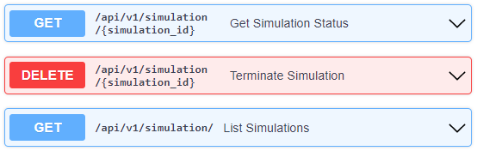
View progress and results
Check simulation progress (or terminate simulation)
View Grafana dashboards
View logs via Lens
1
3
2

Slide 16
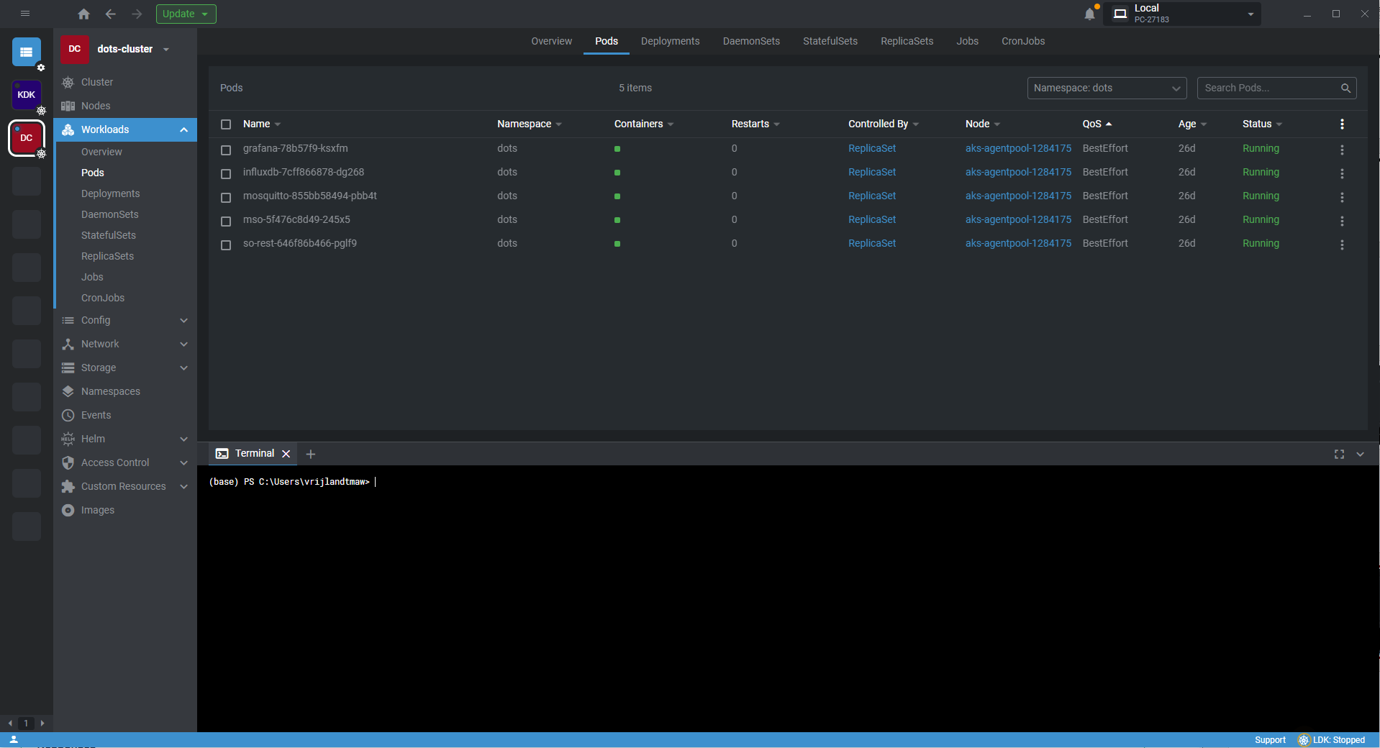

Slide 17
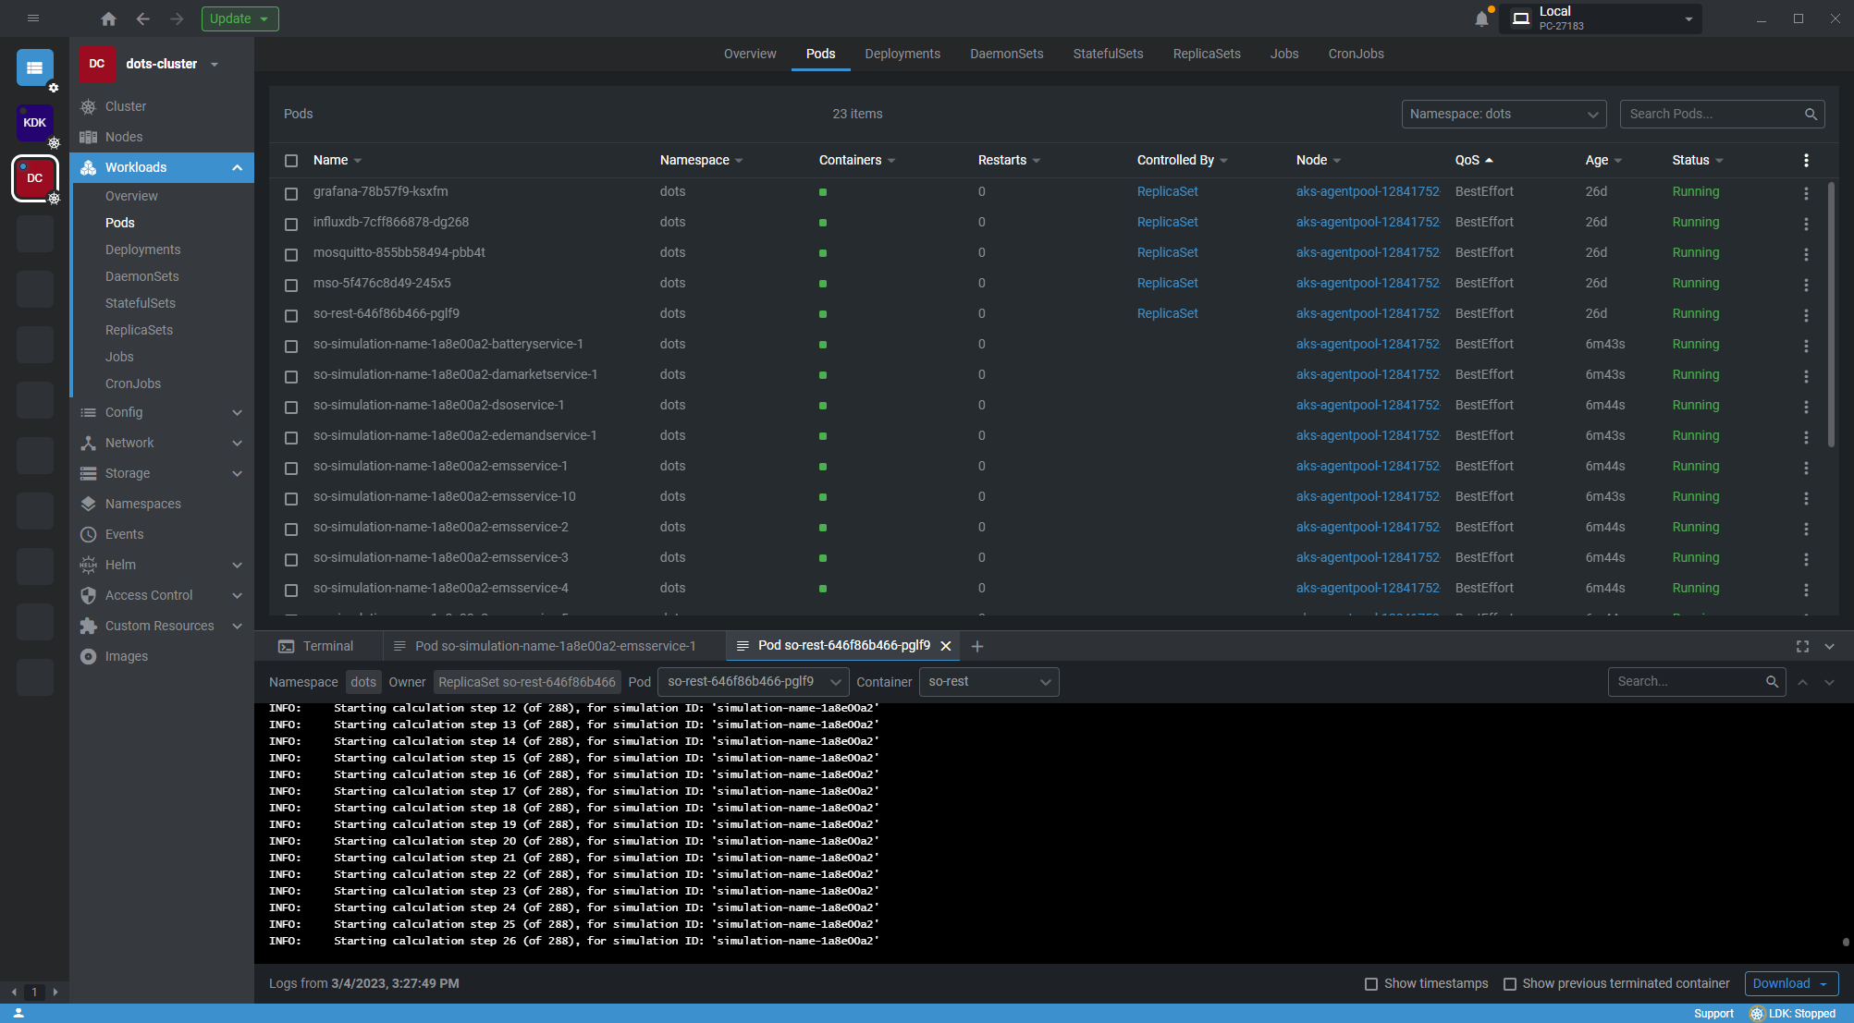

Slide 18
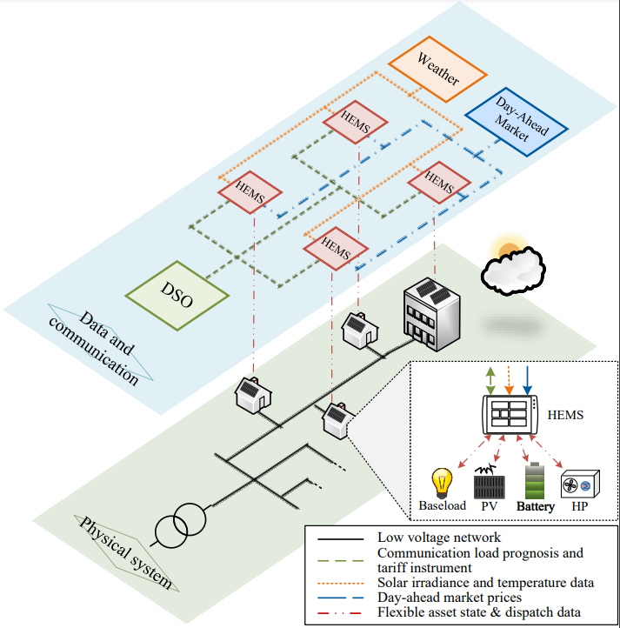
First simulation: Service overview
Low-voltage network (ESDL: energysystem)
Assets:
Baseload (ESDL: Edemand)
PV (ESDL: PVInstallation)
Battery (ESDL: Battery)
Heat pump (ESDL: HeatPump)
Energy Management system (ESDL: Econnection)
Weather (ESDL: EnvironmentalProfile)
Day-ahead market (ESDL: EnergyMarket)
DSO (ESDL: Party)
All in a Building

Slide 19
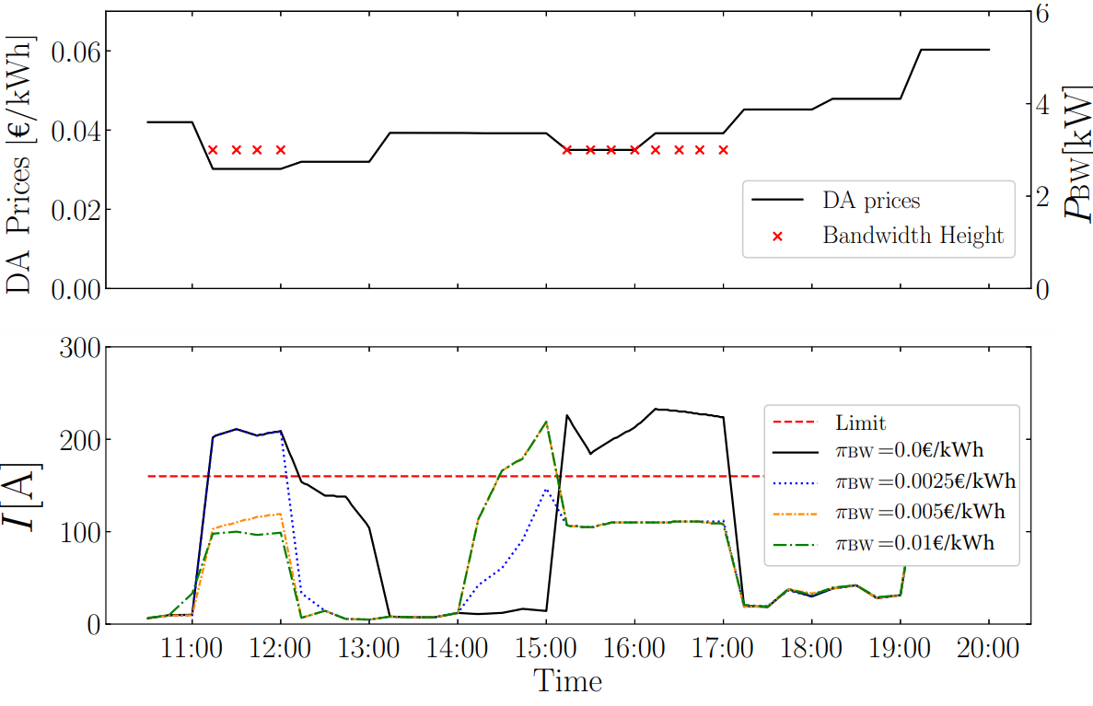
Dynamic Bandwidth tariff
When the DA-prices were low, the DSO expected congestion (mainly due to batteries)
If the bandwidth is active, congestion can be prevented if the associated costs are high enough
Load on the cable
But new congestion can occur in real-time

Slide 20

Abstract accepted

Slide 21
Learnings
Cookiecutter works well for configurable code generation
Jinja2 templating
Pre- and post-gen hooks
Setup to run in utility Docker container (also takes care of protobuf compile)
Good corporation with TU scientists: they can focus on python implementation
Reuse of existing component (Model Services Orchestrator) from another project with only a couple of changes and additions needed

Slide 22
Ideas for future development
Move from ci.tno.nl to open source
Efficient update of existing calculation services (add/change IO data)
Currently all data communication goes via MQTT, for large datasets allow via database?
Run multiple simulations in a loop?
Cloud monitoring, put to sleep when not used
Automated testing of microservices
Incorporate S2 Flexibility Protocol for communication between energy objects
Build front-end for easier simulation management (calculation flow diagram) and viewing of results
Create library of services
Use Microservice Cloud Simulator (MCS) for other types of simulations consisting of different components
Some changes needed in the ‘Simulation Orchestrator’ and ‘Calculation Service Generator’
Future projects: DEMOSES?, …

Slide 24
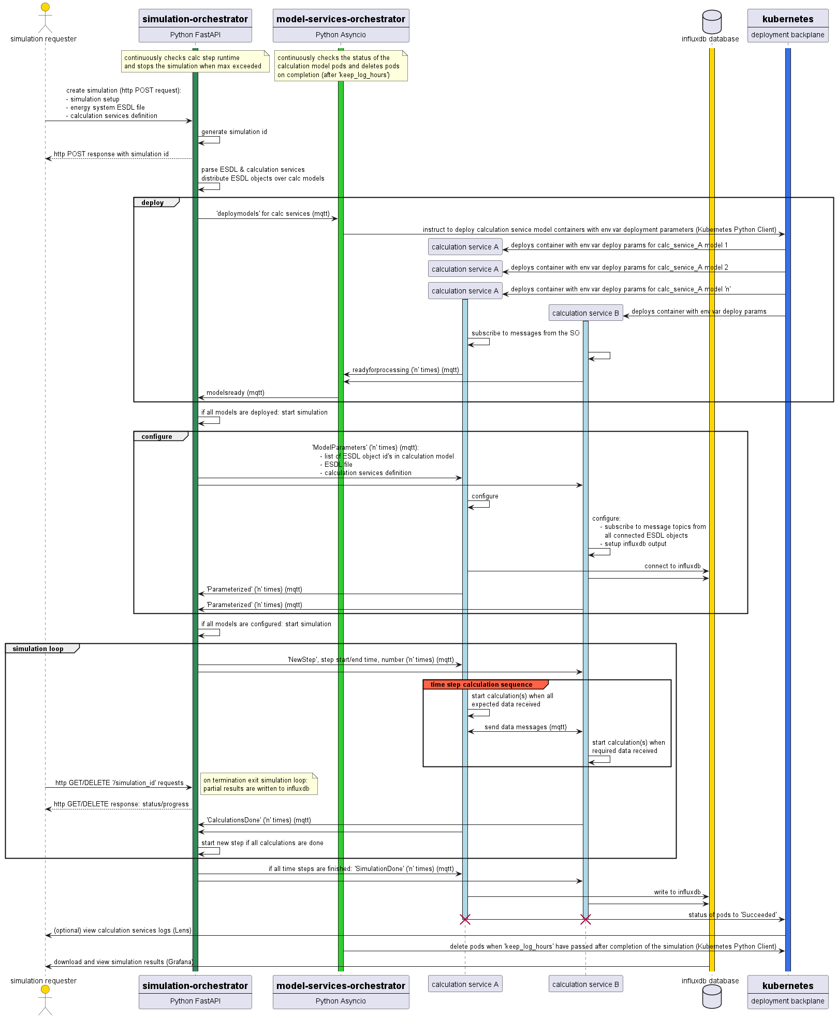
Sequence diagram

Slide 25
Sequence diagram: deploy

Slide 26
Sequence diagram: configure

Slide 27
Sequence diagram: simulation loop

Slide 28
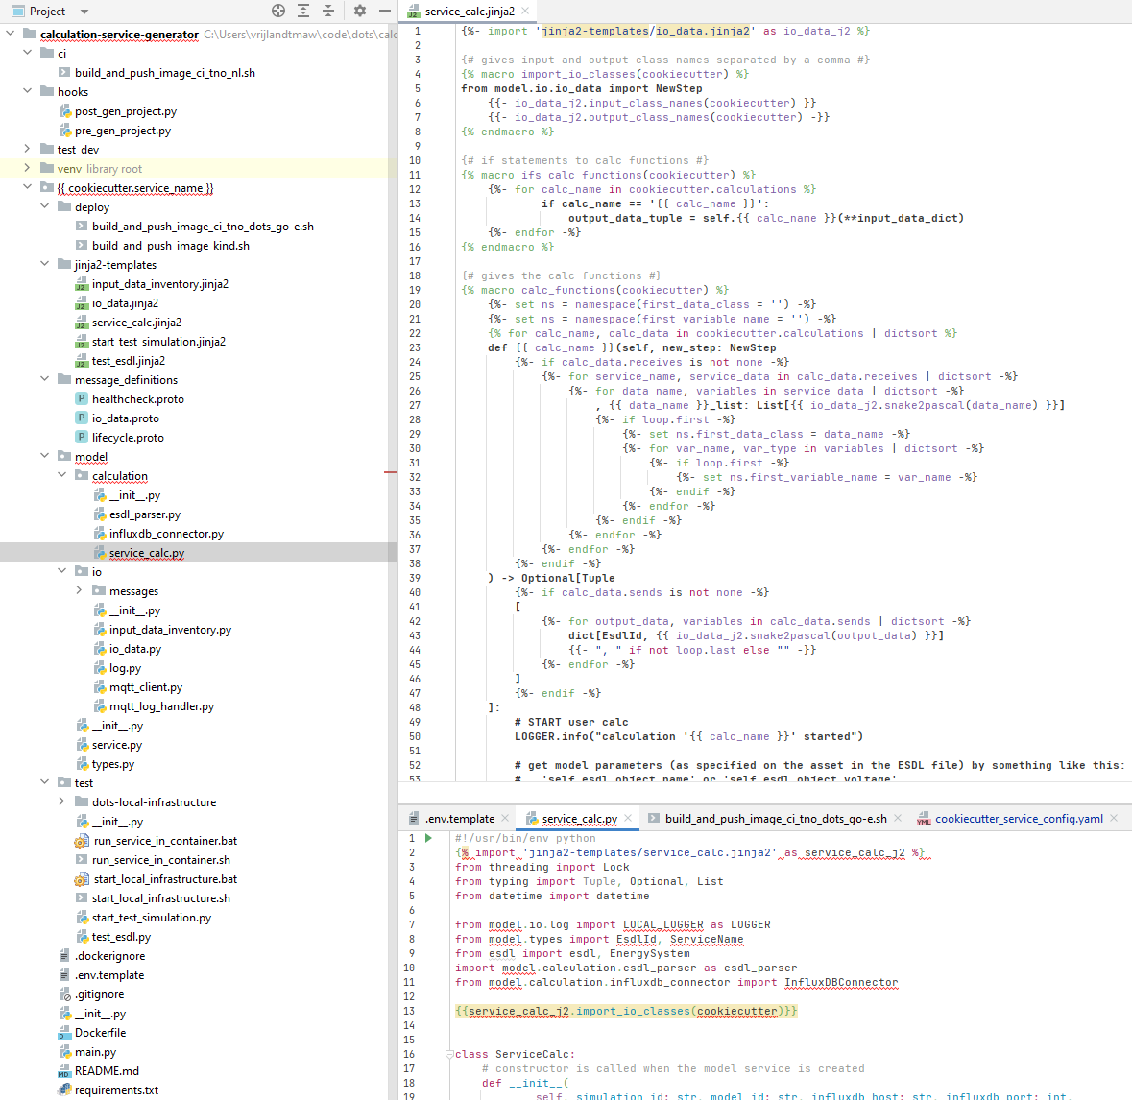

Slide 29
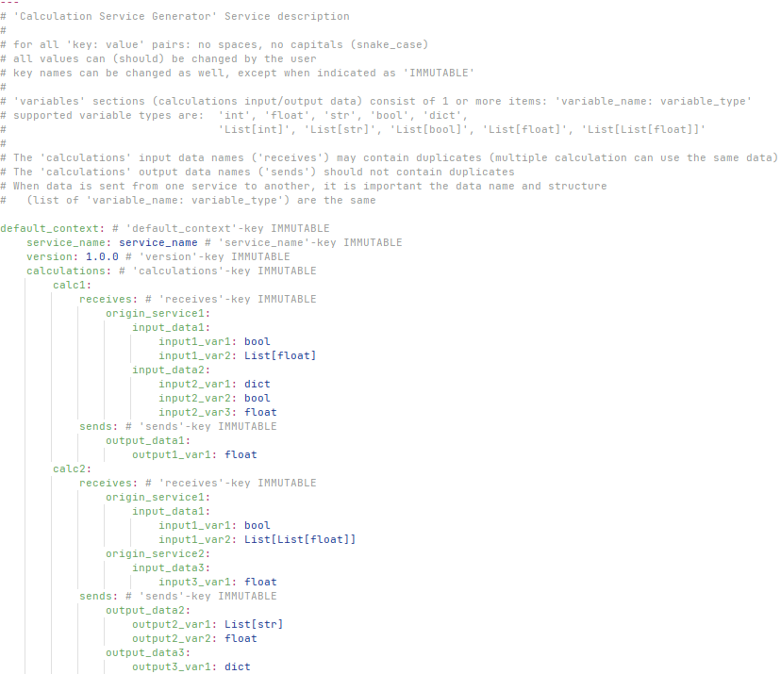

Slide 30
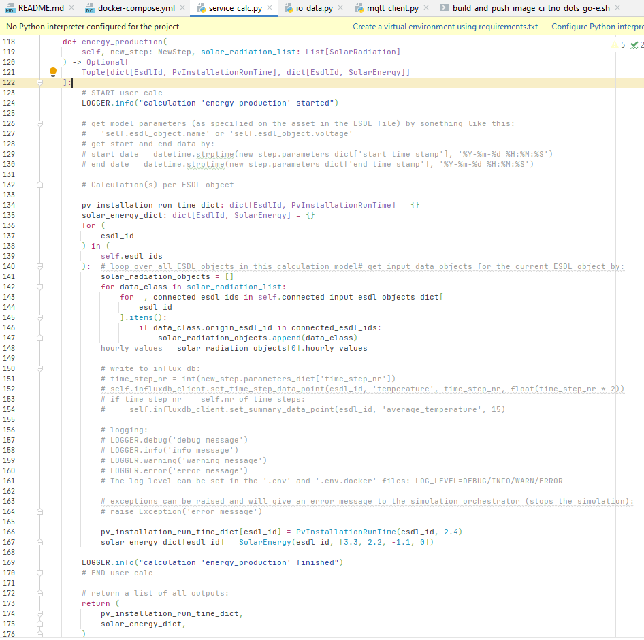

Slide 31
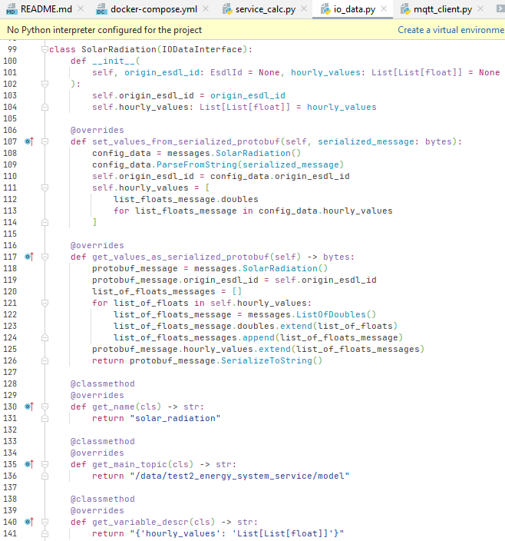

Slide 32
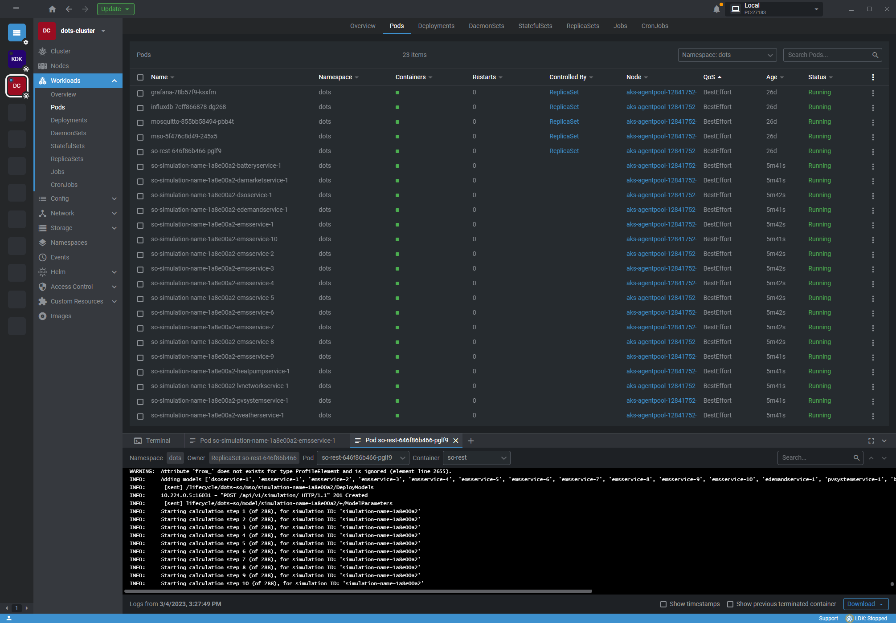

Slide 33
Dynamic bandwidth tariff
EMS 1
Send aggregated loads for next day per phase to DSO
Send updated bandwidth height to all connected EMS
EMS 1
EMS 1
DSO
EMS 1
…
…
EMS n
Perform load flow for next day, determine expected congestion problems, adjust bandwidth height* on congestion timesteps
EMS n
Aggregate load prognosis for next day for each of the connected phases
T
Expected Congestion moment
T
Expected Congestion moment
T
Expected Congestion moment
00:00
00:00
00:00
12:00
DA Closing
00:00
* DSO sends out bandwidth list for 96 timesteps :
If load flow indicates no congestion - > No bandwidth in place [ NaN, NaN, NaN, NaN , NaN, NaN … NaN ]
If load flow indicates congestion -> Bandwidth in place on timesteps of expected congestion [ NaN, 3000, 3000, NaN, 3000, NaN … NaN ]
T
Expected Congestion moment
T
Expected Congestion moment

